Slide 1

2015 CoACT Data Analysis

Slide 2
Outline
Data Review
Analysis Goals
District Level Analysis
Network Level
School Level
Individual School – 452 Case Study

Slide 3
Data Review
2015 CoACT results
Benchmark for College Preparedness
Key thresholds in scoring
18 in English
22 in Mathematics
22 in Reading
18 in Science

Slide 4
Analysis Goals
Understand global performance trends
Identify relative strengthens and weaknesses at network and school level
Identify vulnerable student demographics to focus resource distribution for corrective action and prioritization

Slide 5
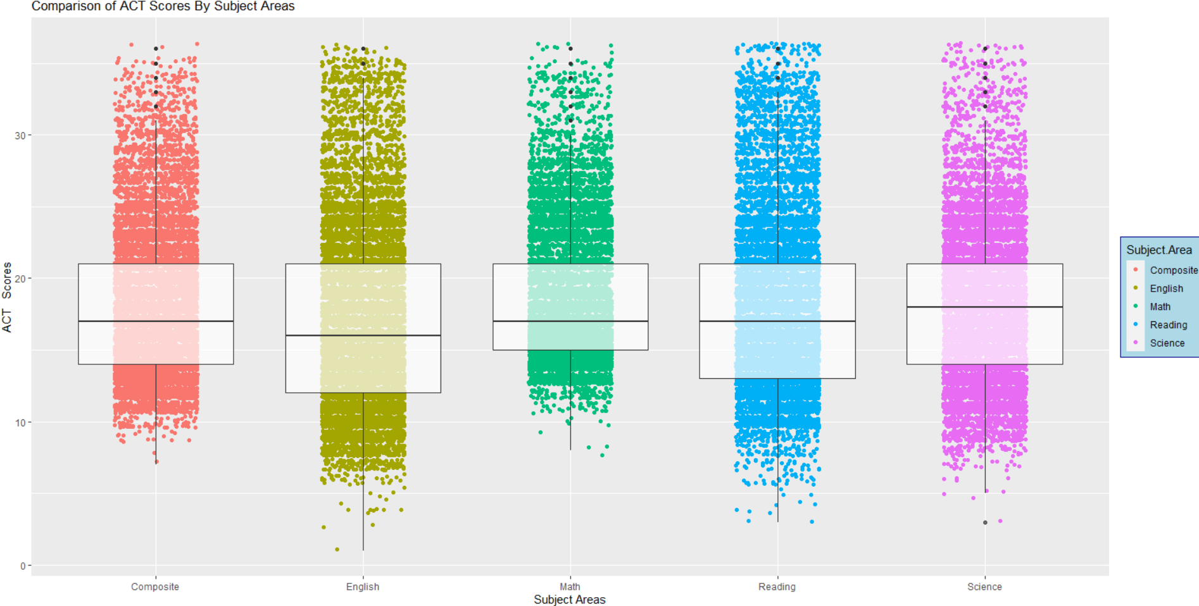
District Analysis

Slide 6
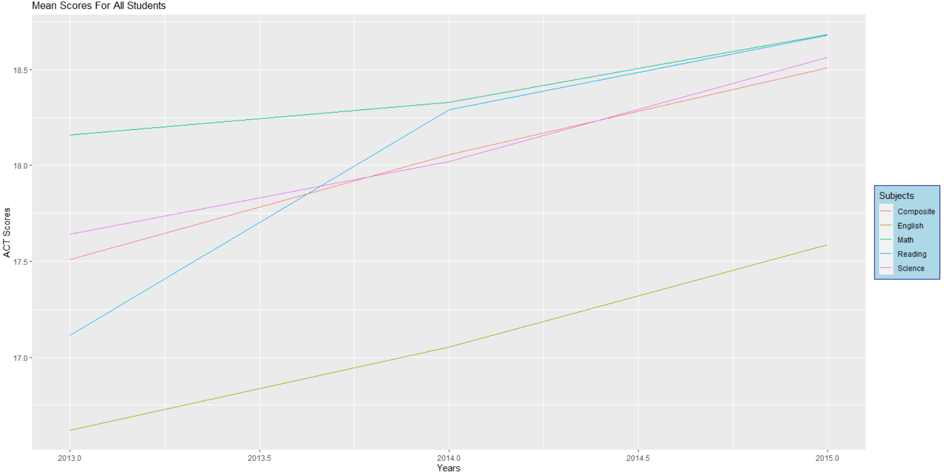

Slide 7
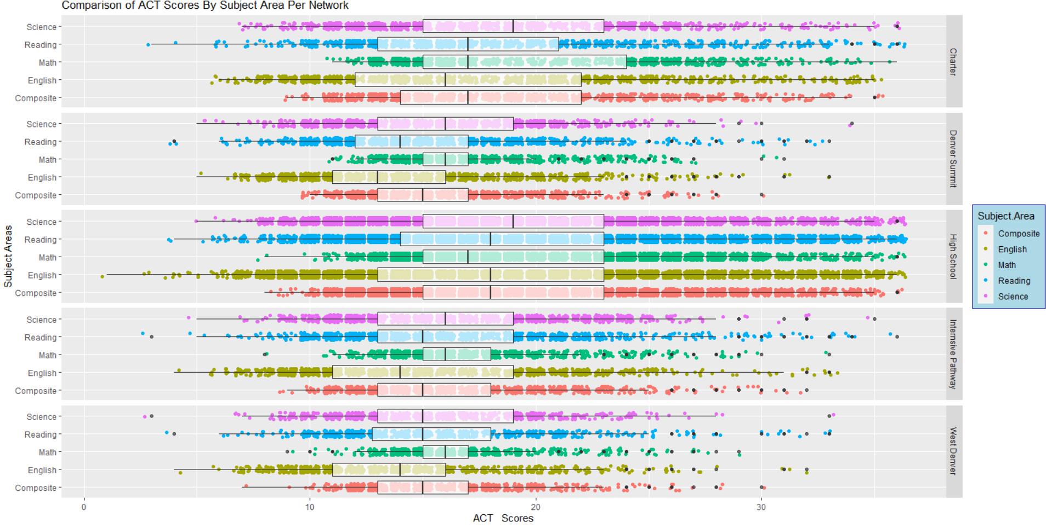
Network Level

Slide 8
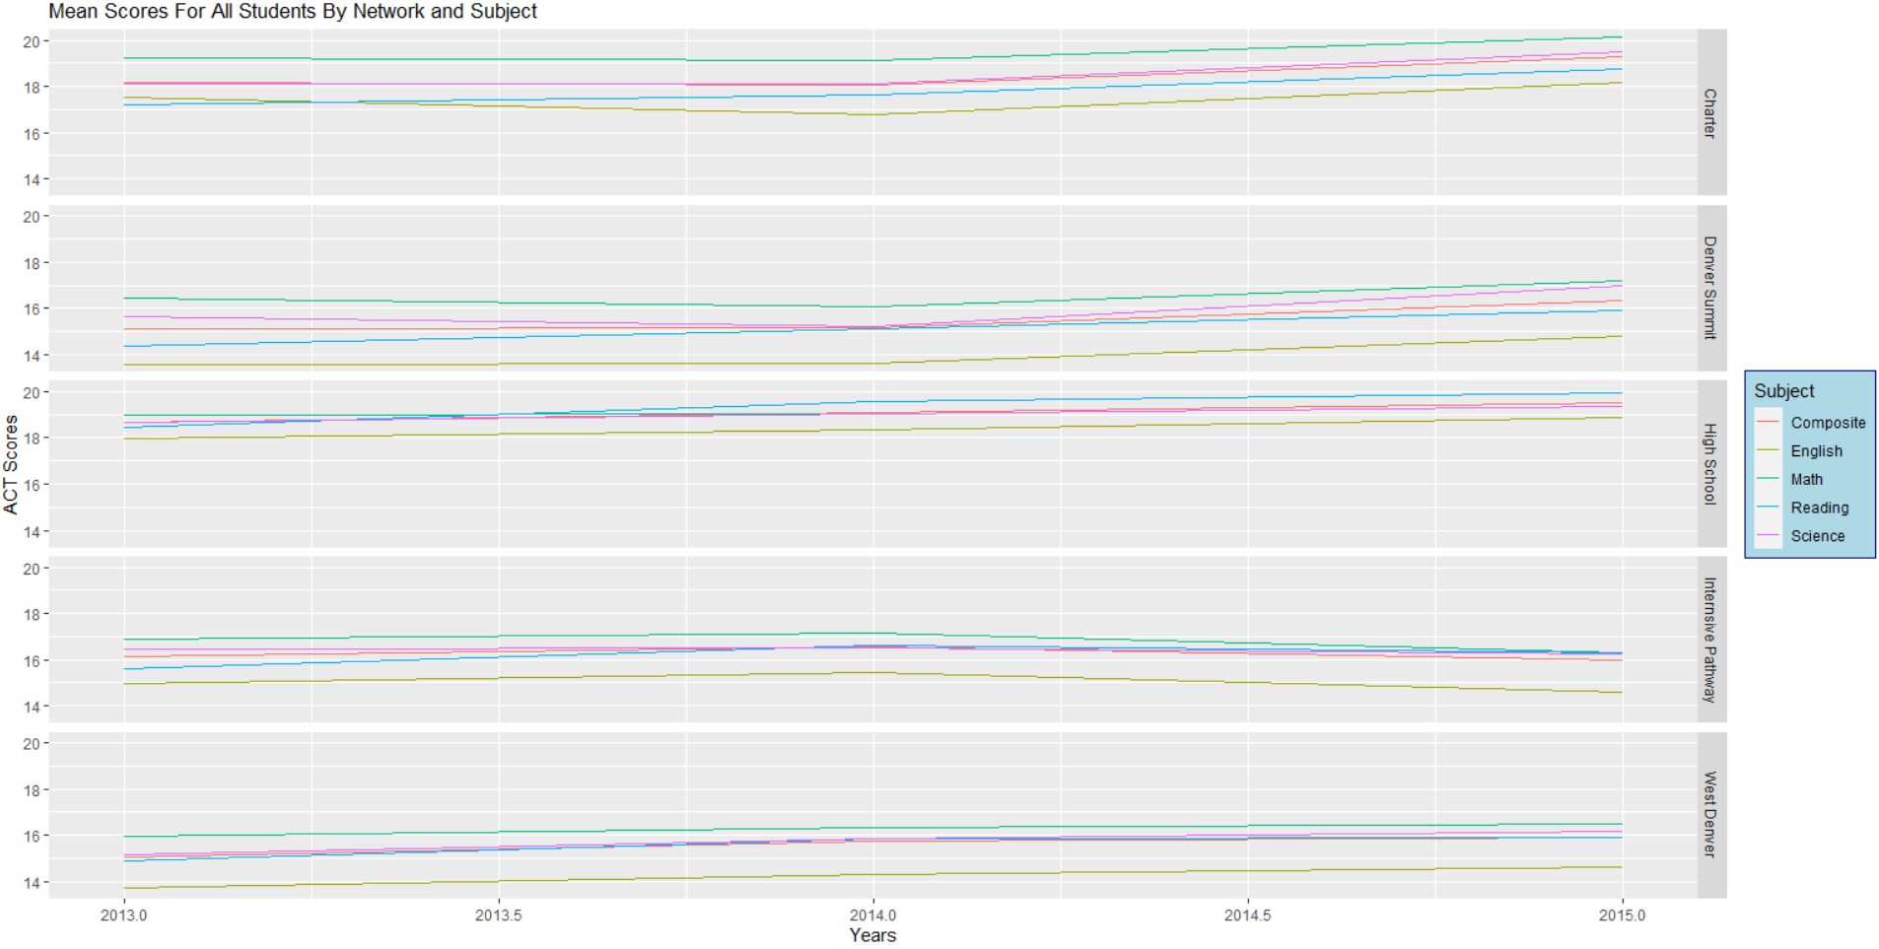

Slide 9
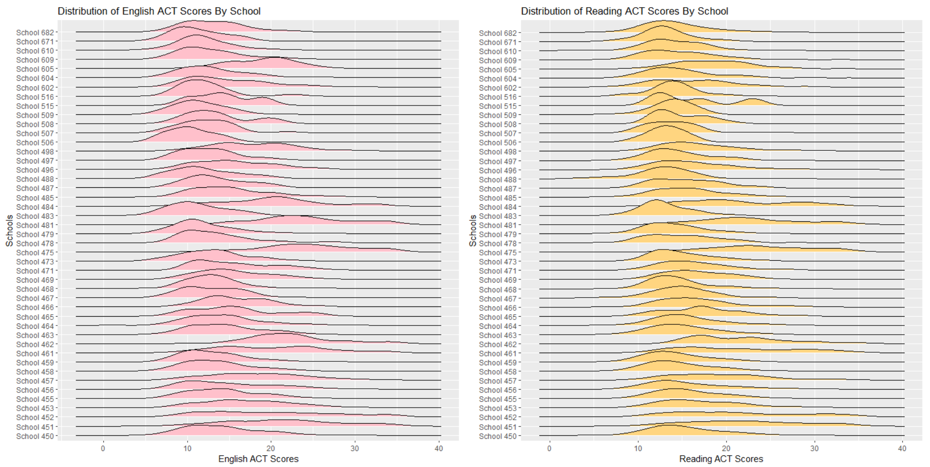
School Level Analysis

Slide 10
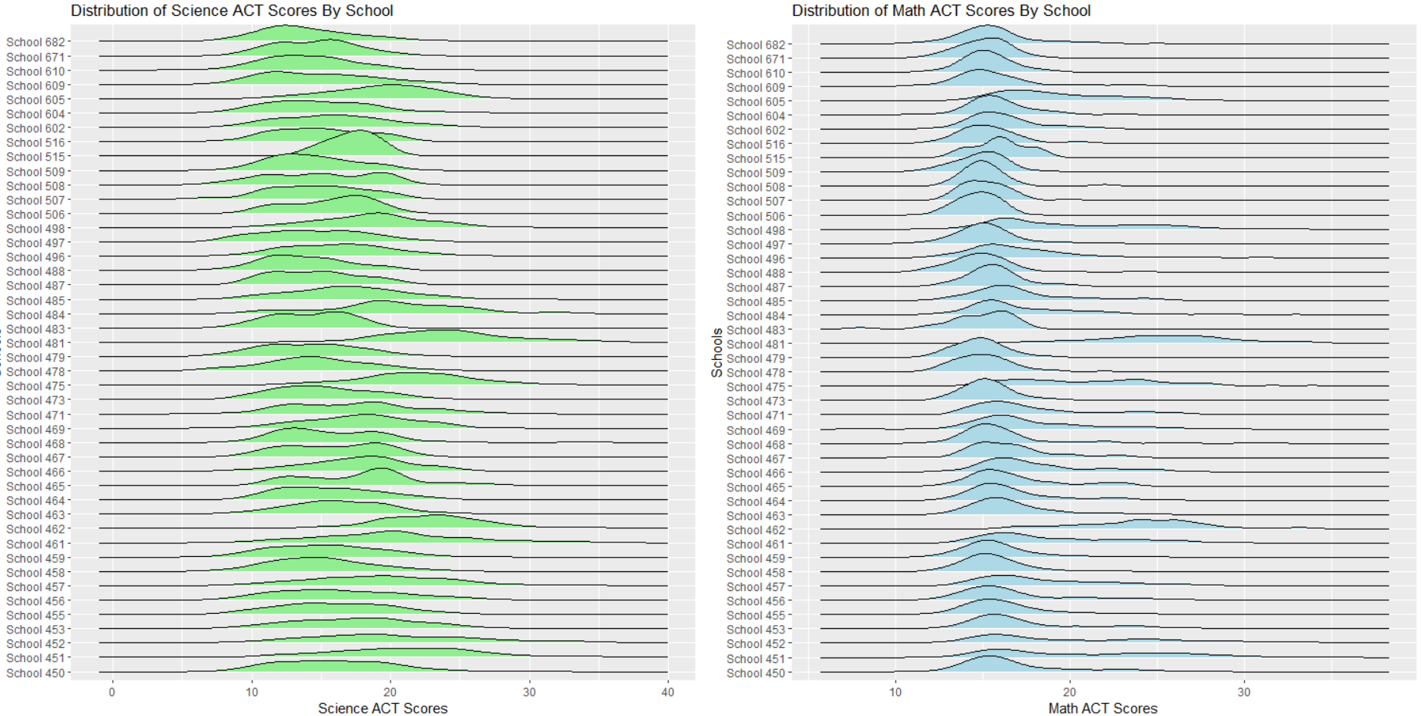

Slide 11
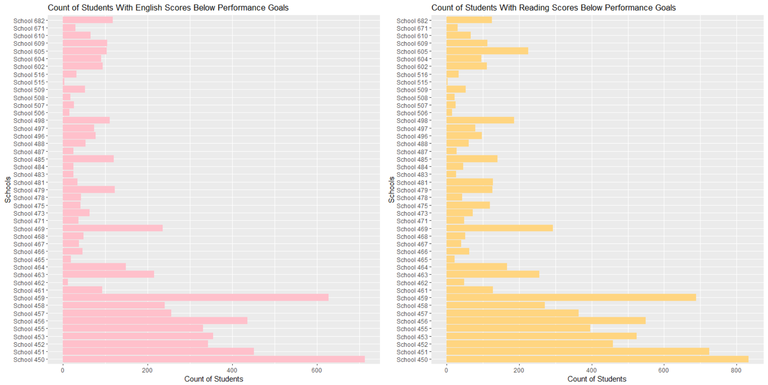

Slide 12
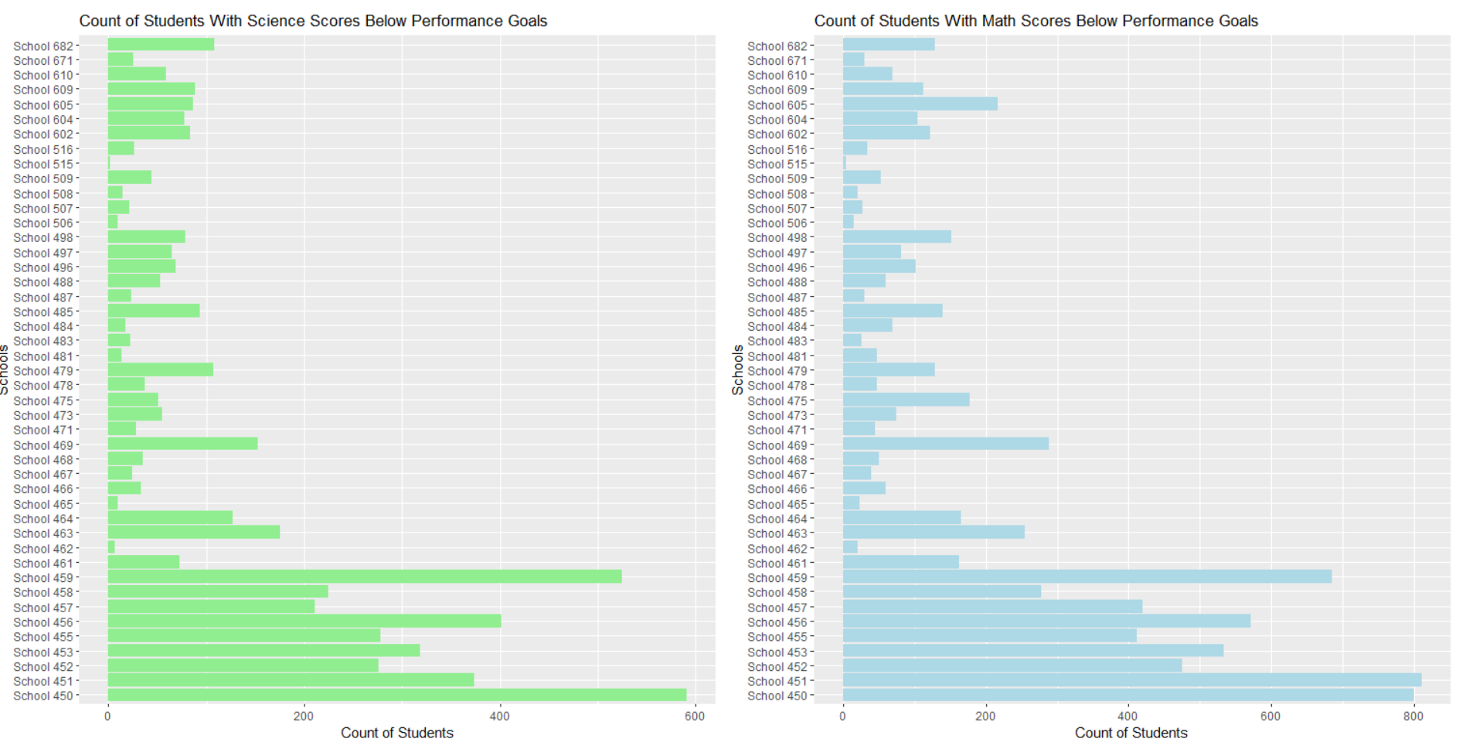

Slide 13
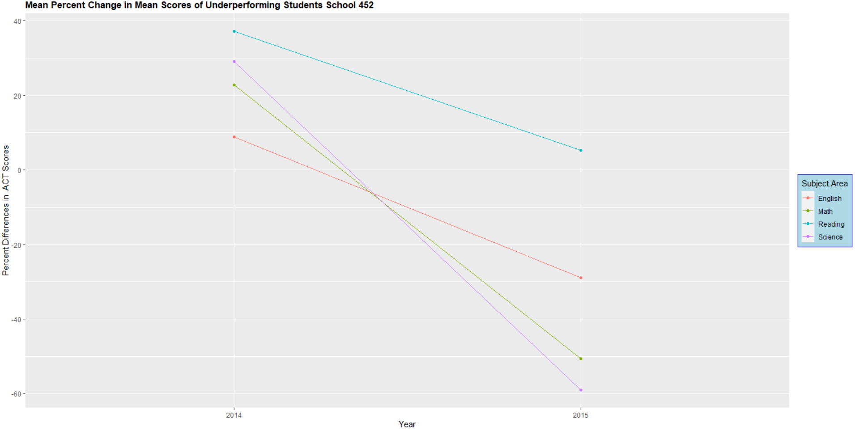
Case Study: School 452

Slide 14
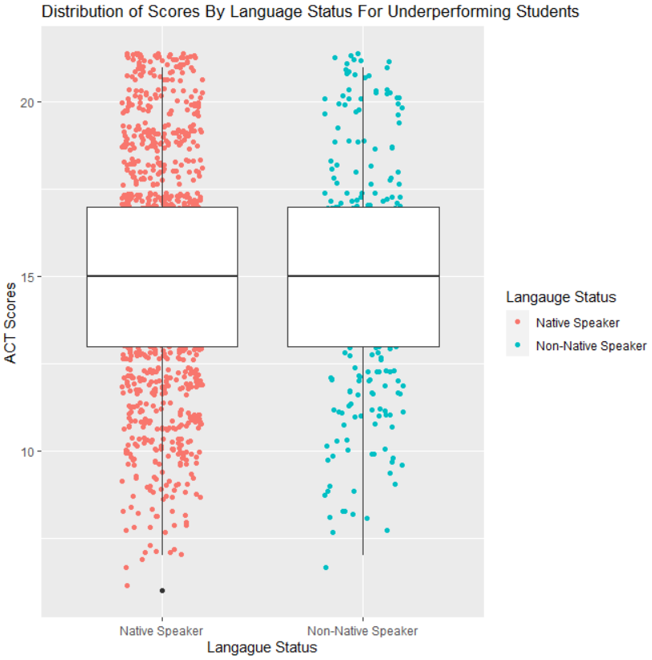
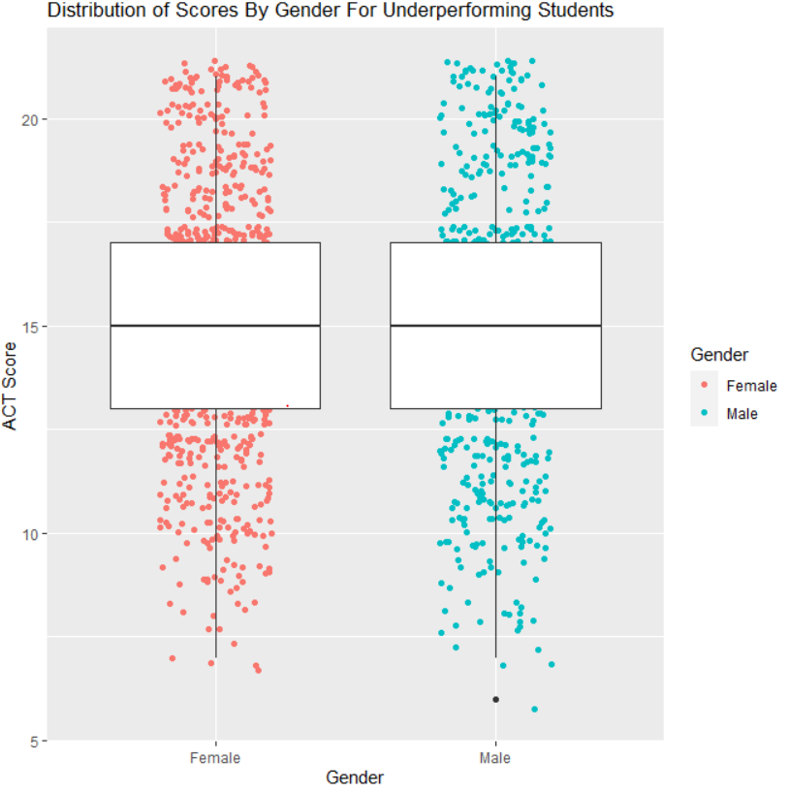

Slide 15
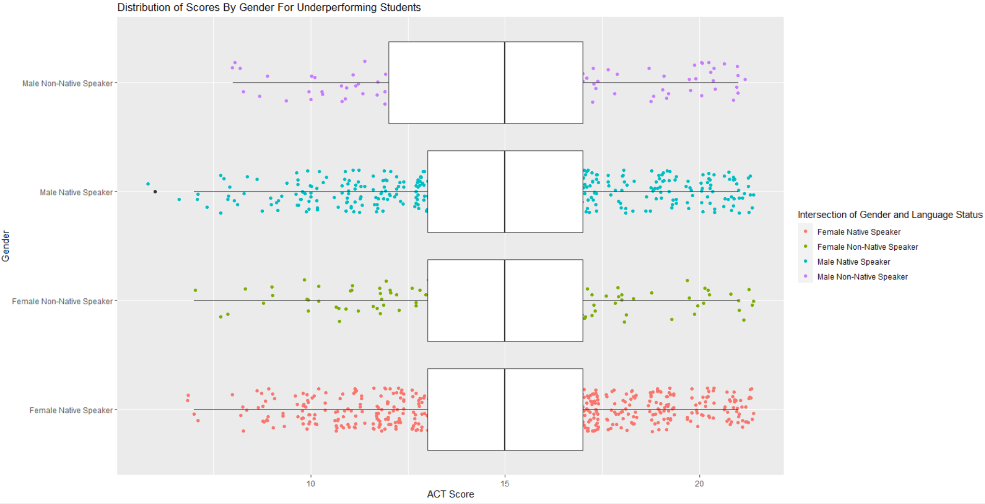

Slide 16
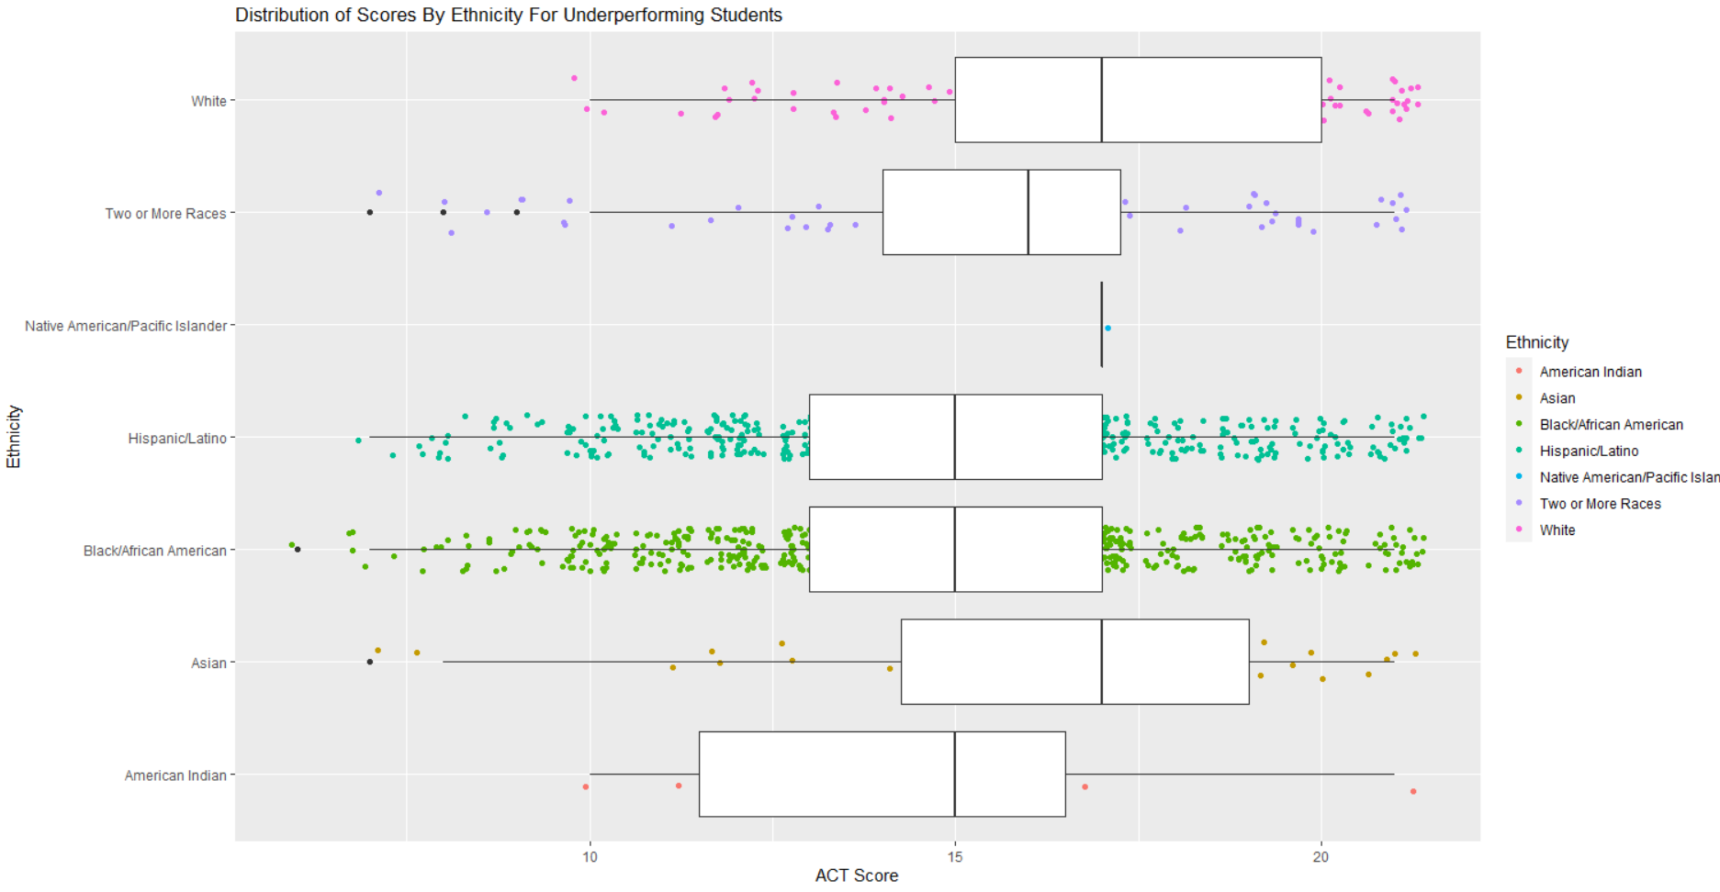

Slide 17
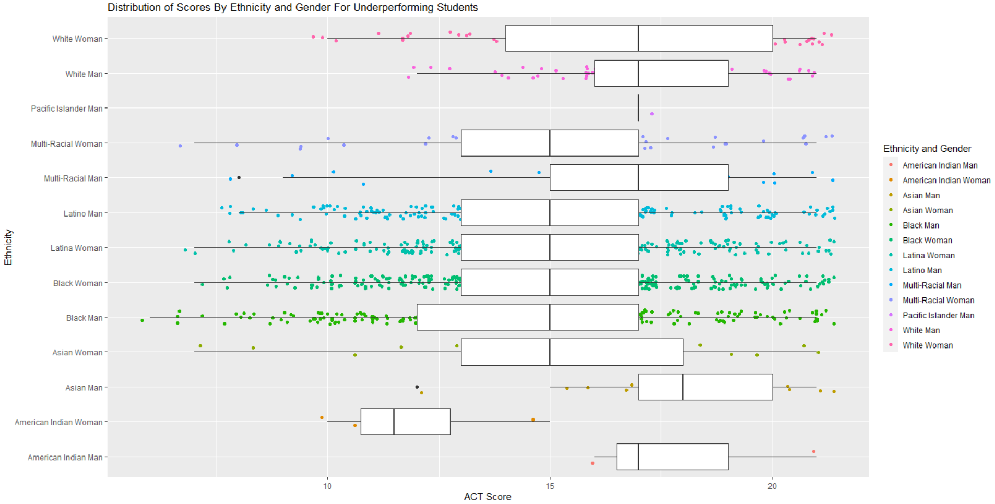

Slide 18
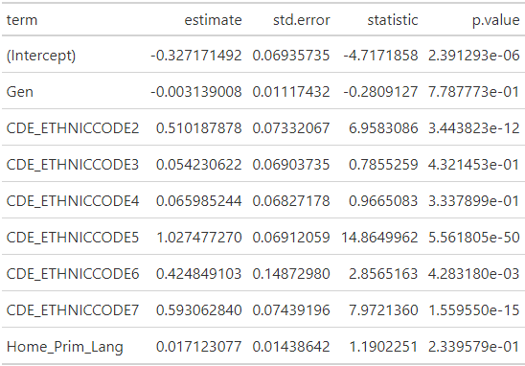
Regression Analysis
Probit Model
Binary dependent variable
Dependent Variable is if a student was prepared based on threshold values
Interaction Terms Not included due to VIF

Slide 19
Recommendations
Macro
Focus on investment and initiatives with Mathematics and Reading
Mean scores still below benchmarks and with Mathematics showing the least progress
Network
Big achievement gap with High School Network and Chart with other networks
Denver Submit and West Denver English scores are concerning and require intervention
Intensive Pathways network lost gains in recent years and is performing less well
Requires intervention starting with a focus on English skills
School
450’s High Schools are generally underperforming
Schools generally appear to be struggling with Mathematics
Future policy should be tailored for this general need considering the macro view of the district
Individual – School 452 Case Study
Male Non-Native English Speakers and American Indian Woman are the most vulnerable demographics and may require additional support
Secondary demographics of concern would be black men as the tails of their distribution were rather long
There is a gap between male and female Asian students that is concerning
It may be useful to organize female empowerment programming to target this gap as it may be culturally based
Pronounced in Native American and Asian demographics

